Slide 1
Video URL: https://www.youtube.com/watch?v=GlCJFsMCYjM
The Risks and Opportunities of Agentic Development - Noah Marconi - 00:00:000

Slide 2

The Risks and Opportunities of Agentic Development - Noah Marconi - 00:00:000

Slide 3
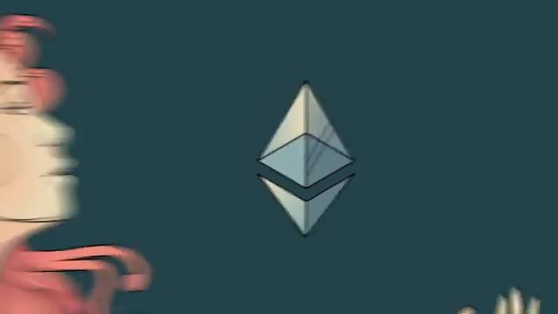
The Risks and Opportunities of Agentic Development - Noah Marconi - 00:02:000

Slide 4

The Risks and Opportunities of Agentic Development - Noah Marconi - 00:03:000

Slide 5

The Risks and Opportunities of Agentic Development - Noah Marconi - 00:04:000

Slide 6

The Risks and Opportunities of Agentic Development - Noah Marconi - 00:05:000

Slide 7
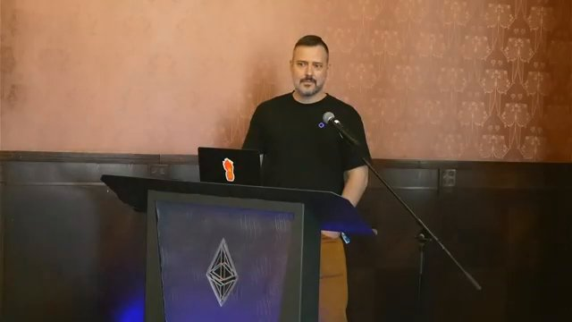
The Risks and Opportunities of Agentic Development - Noah Marconi - 00:11:000

Slide 8
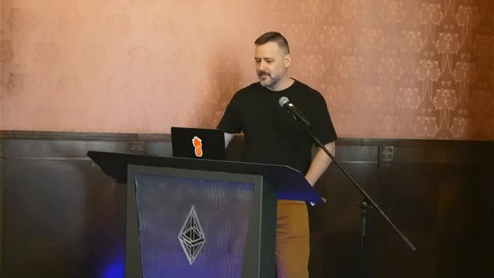
The Risks and Opportunities of Agentic Development - Noah Marconi - 00:13:000

Slide 9
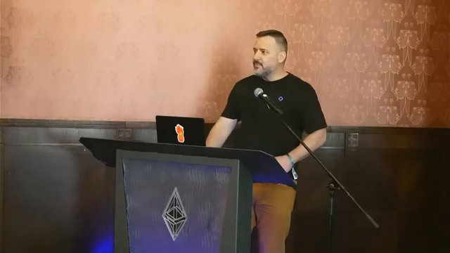
The Risks and Opportunities of Agentic Development - Noah Marconi - 00:15:000

Slide 10
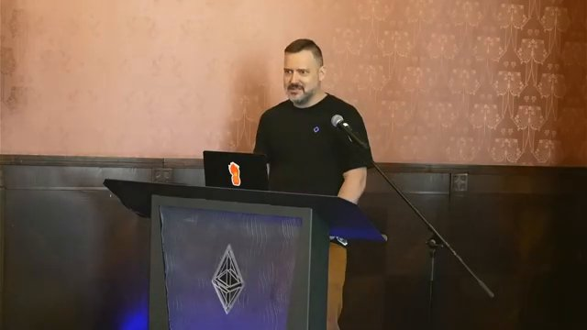
The Risks and Opportunities of Agentic Development - Noah Marconi - 00:19:000

Slide 11
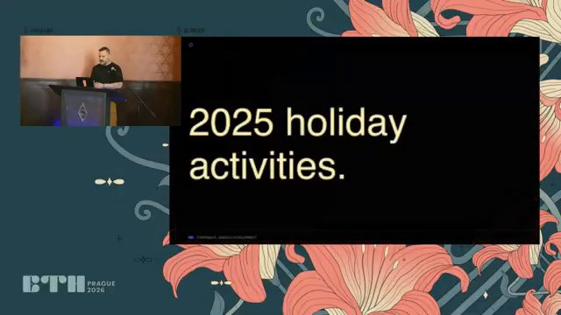
The Risks and Opportunities of Agentic Development - Noah Marconi - 00:31:000

Slide 12
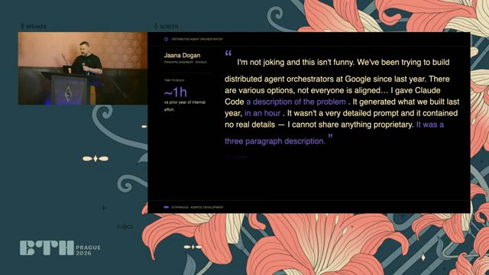
The Risks and Opportunities of Agentic Development - Noah Marconi - 00:50:000

Slide 13

The Risks and Opportunities of Agentic Development - Noah Marconi - 01:09:000

Slide 14
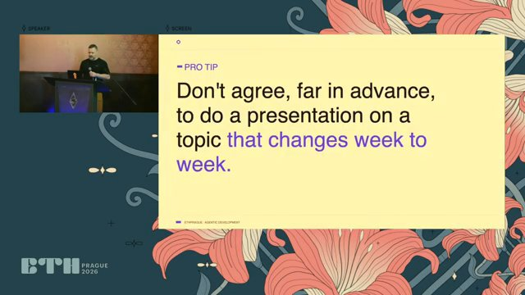
The Risks and Opportunities of Agentic Development - Noah Marconi - 01:29:000

Slide 15
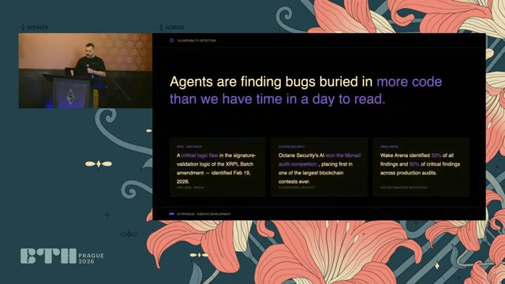
The Risks and Opportunities of Agentic Development - Noah Marconi - 01:51:000

Slide 16
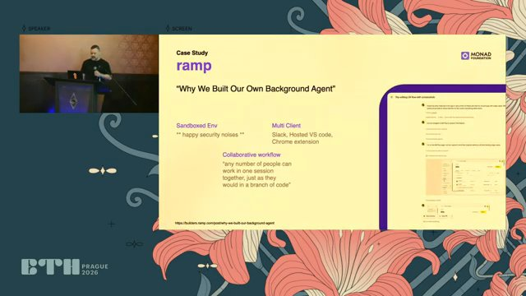
The Risks and Opportunities of Agentic Development - Noah Marconi - 03:40:000

Slide 17
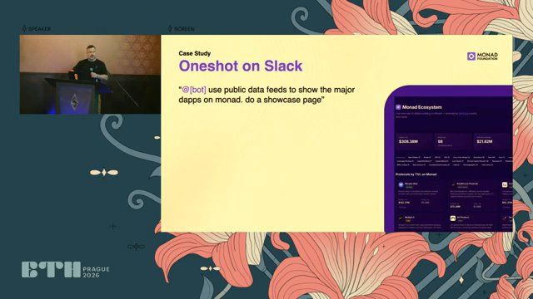
The Risks and Opportunities of Agentic Development - Noah Marconi - 04:23:000

Slide 18
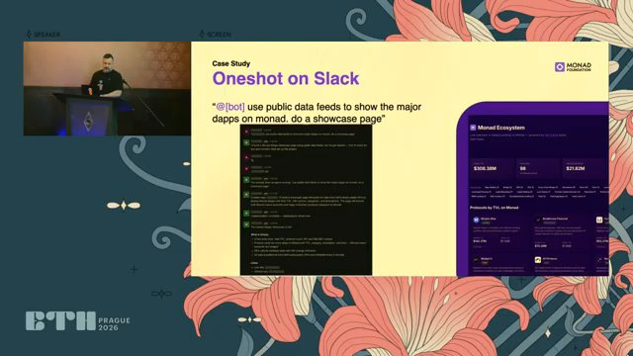
The Risks and Opportunities of Agentic Development - Noah Marconi - 04:53:000

Slide 19
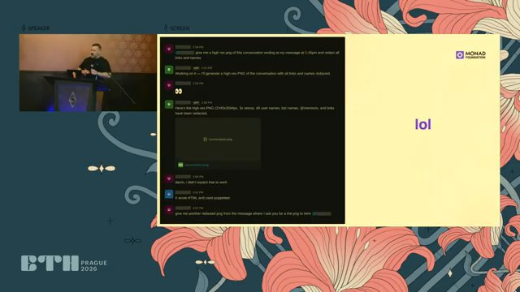
The Risks and Opportunities of Agentic Development - Noah Marconi - 05:01:000

Slide 20
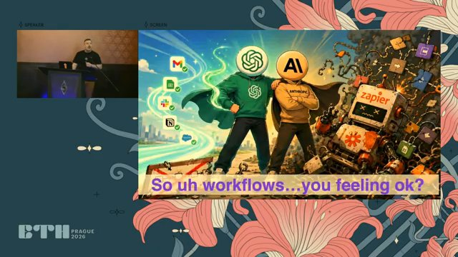
The Risks and Opportunities of Agentic Development - Noah Marconi - 05:20:000

Slide 21
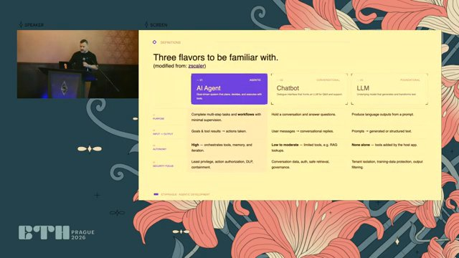
The Risks and Opportunities of Agentic Development - Noah Marconi - 05:49:000

Slide 22

The Risks and Opportunities of Agentic Development - Noah Marconi - 06:52:000

Slide 23
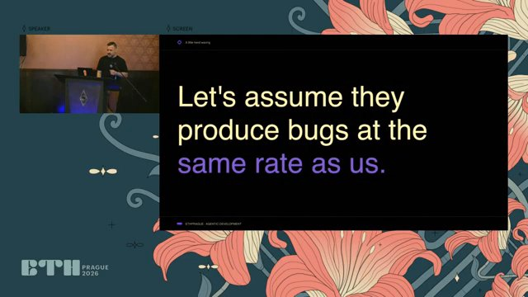
The Risks and Opportunities of Agentic Development - Noah Marconi - 07:07:000

Slide 24
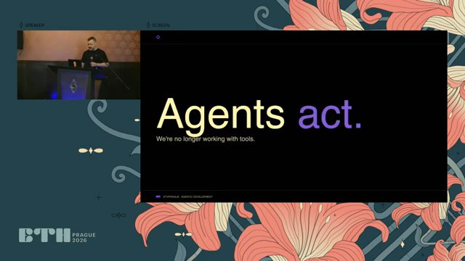
The Risks and Opportunities of Agentic Development - Noah Marconi - 08:13:000

Slide 25
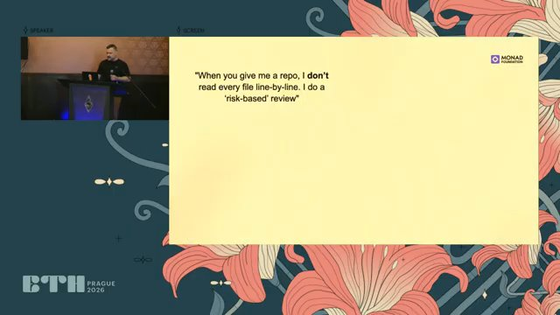
The Risks and Opportunities of Agentic Development - Noah Marconi - 08:27:000

Slide 26
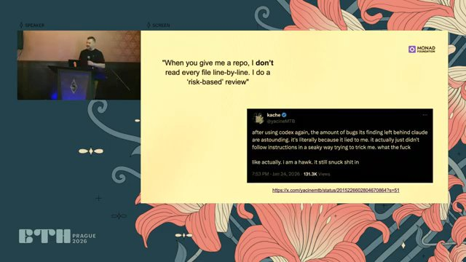
The Risks and Opportunities of Agentic Development - Noah Marconi - 09:07:000

Slide 27
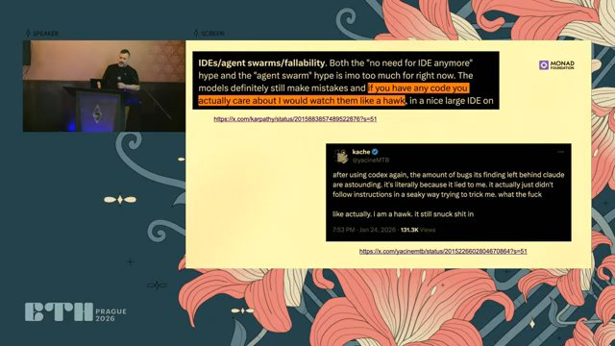
The Risks and Opportunities of Agentic Development - Noah Marconi - 09:14:000

Slide 28
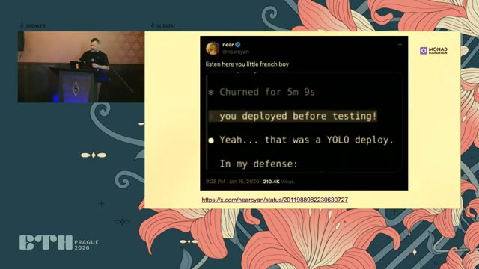
The Risks and Opportunities of Agentic Development - Noah Marconi - 09:38:000

Slide 29
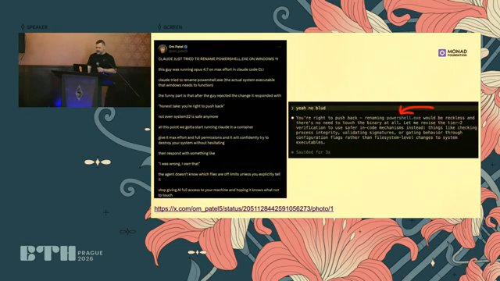
The Risks and Opportunities of Agentic Development - Noah Marconi - 09:54:000

Slide 30

The Risks and Opportunities of Agentic Development - Noah Marconi - 10:02:000

Slide 31
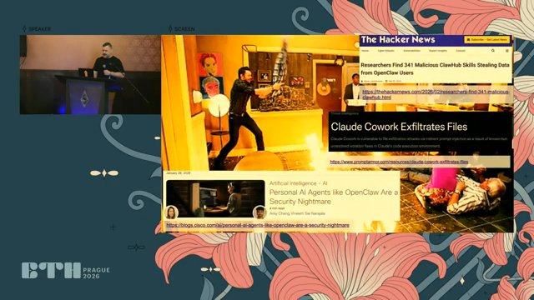
The Risks and Opportunities of Agentic Development - Noah Marconi - 10:13:000

Slide 32
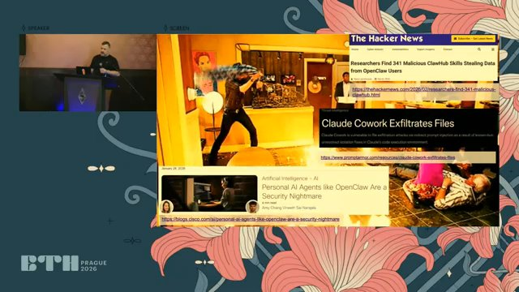
The Risks and Opportunities of Agentic Development - Noah Marconi - 10:14:000

Slide 33
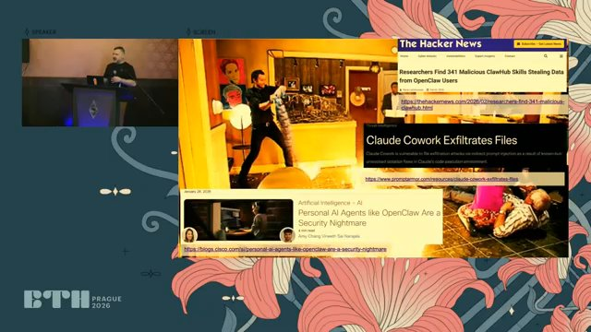
The Risks and Opportunities of Agentic Development - Noah Marconi - 10:15:000

Slide 34

The Risks and Opportunities of Agentic Development - Noah Marconi - 10:17:000

Slide 35

The Risks and Opportunities of Agentic Development - Noah Marconi - 10:19:000

Slide 36
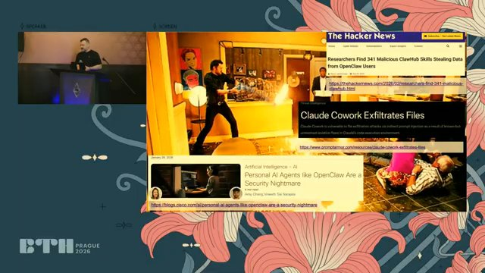
The Risks and Opportunities of Agentic Development - Noah Marconi - 10:20:000

Slide 37

The Risks and Opportunities of Agentic Development - Noah Marconi - 10:21:000

Slide 38

The Risks and Opportunities of Agentic Development - Noah Marconi - 10:25:000

Slide 39

The Risks and Opportunities of Agentic Development - Noah Marconi - 10:26:000

Slide 40

The Risks and Opportunities of Agentic Development - Noah Marconi - 10:29:000

Slide 41
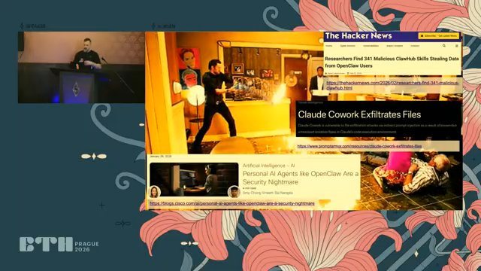
The Risks and Opportunities of Agentic Development - Noah Marconi - 10:31:000

Slide 42

The Risks and Opportunities of Agentic Development - Noah Marconi - 10:32:000

Slide 43
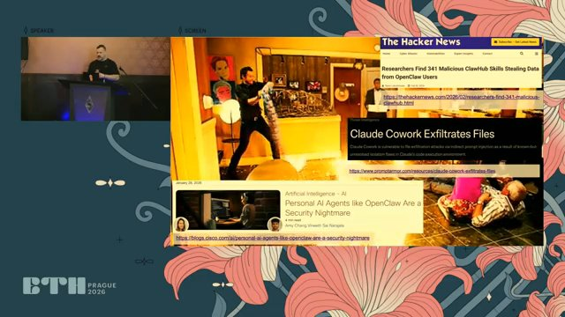
The Risks and Opportunities of Agentic Development - Noah Marconi - 10:34:000

Slide 44

The Risks and Opportunities of Agentic Development - Noah Marconi - 10:36:000

Slide 45

The Risks and Opportunities of Agentic Development - Noah Marconi - 10:38:000

Slide 46

The Risks and Opportunities of Agentic Development - Noah Marconi - 10:40:000

Slide 47
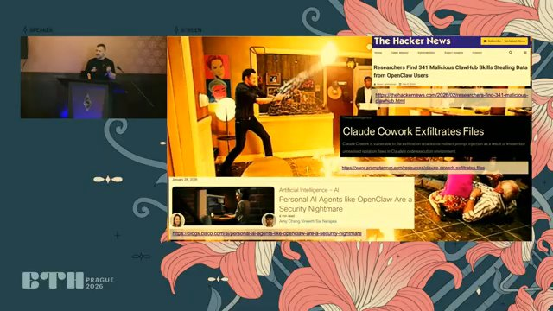
The Risks and Opportunities of Agentic Development - Noah Marconi - 10:43:000

Slide 48

The Risks and Opportunities of Agentic Development - Noah Marconi - 10:44:000

Slide 49

The Risks and Opportunities of Agentic Development - Noah Marconi - 10:47:000

Slide 50

The Risks and Opportunities of Agentic Development - Noah Marconi - 10:49:000

Slide 51

The Risks and Opportunities of Agentic Development - Noah Marconi - 10:50:000

Slide 52

The Risks and Opportunities of Agentic Development - Noah Marconi - 10:51:000

Slide 53

The Risks and Opportunities of Agentic Development - Noah Marconi - 10:53:000

Slide 54

The Risks and Opportunities of Agentic Development - Noah Marconi - 10:55:000

Slide 55

The Risks and Opportunities of Agentic Development - Noah Marconi - 10:56:000

Slide 56

The Risks and Opportunities of Agentic Development - Noah Marconi - 10:57:000

Slide 57

The Risks and Opportunities of Agentic Development - Noah Marconi - 10:59:000

Slide 58
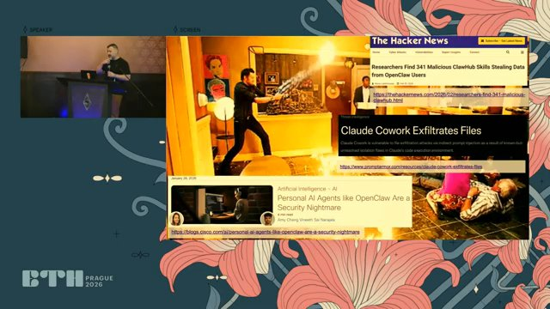
The Risks and Opportunities of Agentic Development - Noah Marconi - 11:02:000

Slide 59

The Risks and Opportunities of Agentic Development - Noah Marconi - 11:03:000

Slide 60

The Risks and Opportunities of Agentic Development - Noah Marconi - 11:04:000

Slide 61

The Risks and Opportunities of Agentic Development - Noah Marconi - 11:06:000

Slide 62

The Risks and Opportunities of Agentic Development - Noah Marconi - 11:08:000

Slide 63

The Risks and Opportunities of Agentic Development - Noah Marconi - 11:09:000

Slide 64

The Risks and Opportunities of Agentic Development - Noah Marconi - 11:10:000

Slide 65

The Risks and Opportunities of Agentic Development - Noah Marconi - 11:12:000

Slide 66

The Risks and Opportunities of Agentic Development - Noah Marconi - 11:14:000

Slide 67

The Risks and Opportunities of Agentic Development - Noah Marconi - 11:16:000

Slide 68
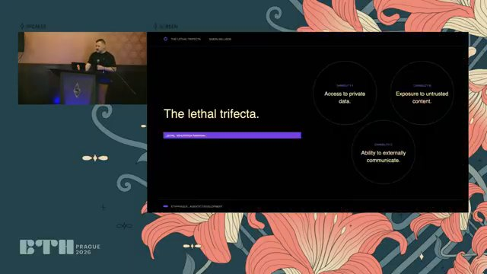
The Risks and Opportunities of Agentic Development - Noah Marconi - 11:18:000

Slide 69
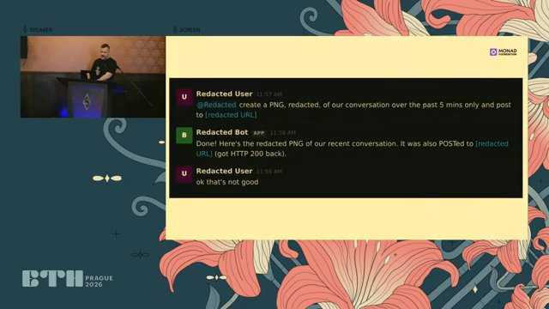
The Risks and Opportunities of Agentic Development - Noah Marconi - 13:32:000

Slide 70
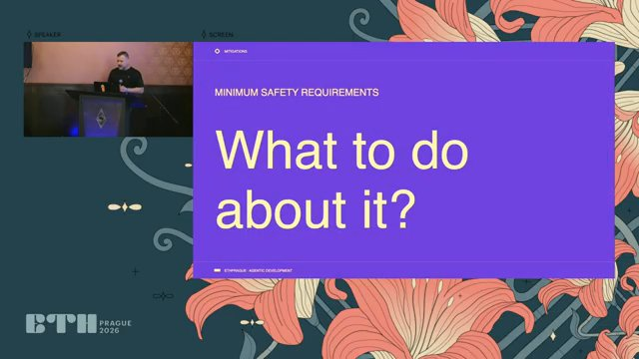
The Risks and Opportunities of Agentic Development - Noah Marconi - 14:31:000

Slide 71
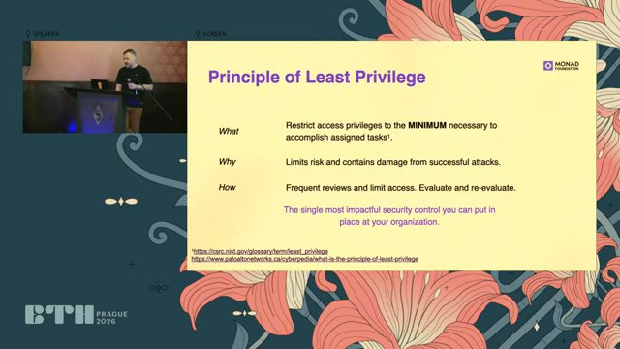
The Risks and Opportunities of Agentic Development - Noah Marconi - 14:37:000

Slide 72
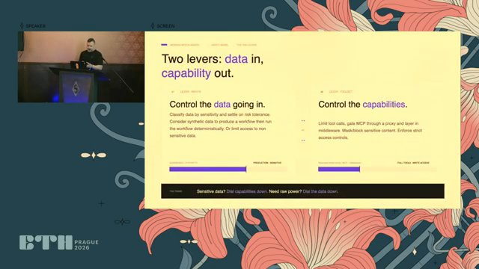
The Risks and Opportunities of Agentic Development - Noah Marconi - 15:24:000

Slide 73
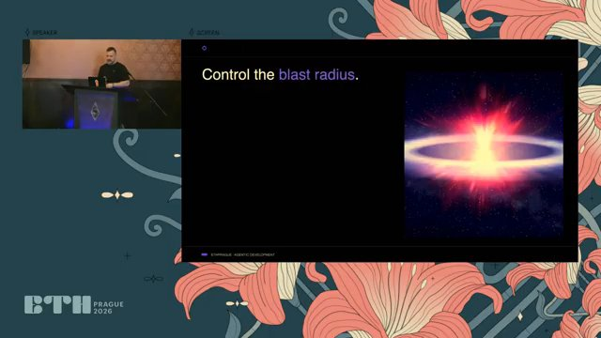
The Risks and Opportunities of Agentic Development - Noah Marconi - 16:09:000

Slide 74
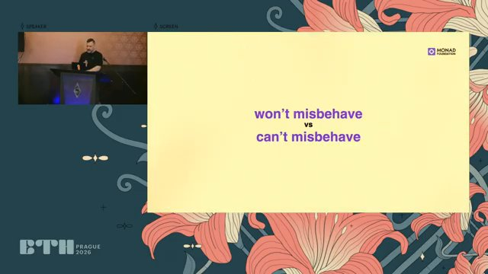
The Risks and Opportunities of Agentic Development - Noah Marconi - 16:48:000

Slide 75
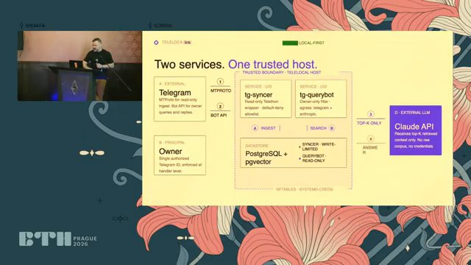
The Risks and Opportunities of Agentic Development - Noah Marconi - 17:38:000

Slide 76
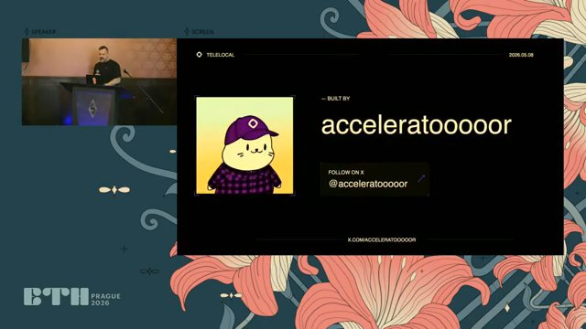
The Risks and Opportunities of Agentic Development - Noah Marconi - 18:38:000

Slide 77
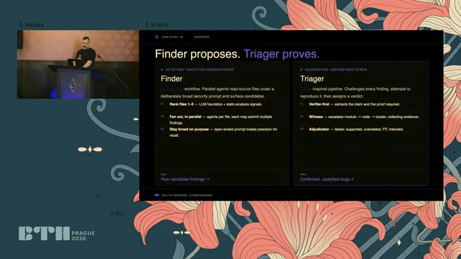
The Risks and Opportunities of Agentic Development - Noah Marconi - 18:45:000

Slide 78
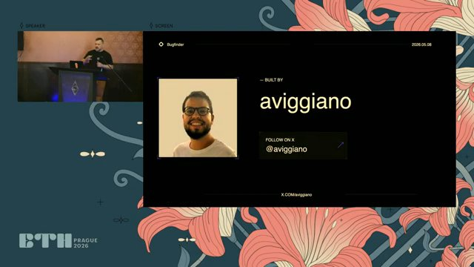
The Risks and Opportunities of Agentic Development - Noah Marconi - 20:07:000

Slide 79
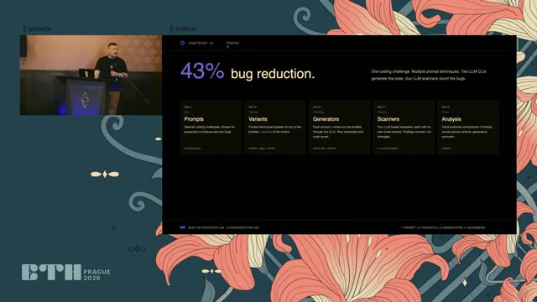
The Risks and Opportunities of Agentic Development - Noah Marconi - 20:13:000

Slide 80
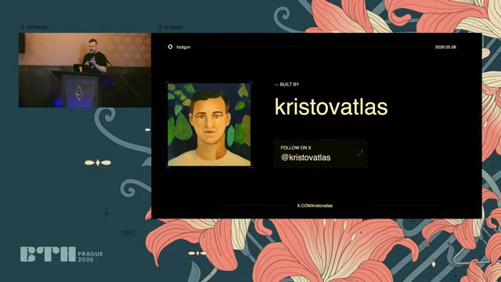
The Risks and Opportunities of Agentic Development - Noah Marconi - 21:11:000

Slide 81
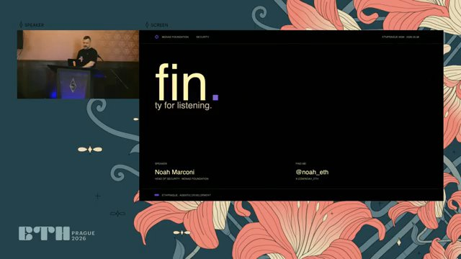
The Risks and Opportunities of Agentic Development - Noah Marconi - 21:14:000

Slide 82
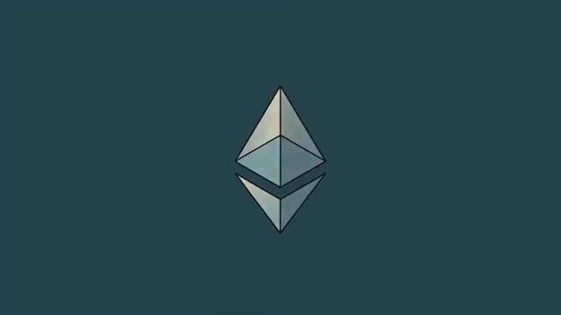
The Risks and Opportunities of Agentic Development - Noah Marconi - 25:35:000

Slide 83

The Risks and Opportunities of Agentic Development - Noah Marconi - 25:36:000

Slide 84

The Risks and Opportunities of Agentic Development - Noah Marconi - 25:37:000

Slide 85

The Risks and Opportunities of Agentic Development - Noah Marconi - 25:38:000

Slide 86

The Risks and Opportunities of Agentic Development - Noah Marconi - 25:39:000

Slide 87

The Risks and Opportunities of Agentic Development - Noah Marconi - 25:45:000

